Slide 1

Object Linking and Embedding(OLE)

Slide 2
What is object linking and embedding (OLE)?
a proprietary technology developed by Microsoft
allows embedding and linking to documents and other objects

Slide 3
How does OLE work?
Add different kinds of data to a document from different applications
Creates a compound document and a master file to which the document makes reference
Changes to data in the master file immediately affect the document that references it

Slide 4
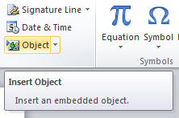
How to use OLE?
Select “Insert” in the ribbon tabs
Select “Objects” on the right side

Slide 5
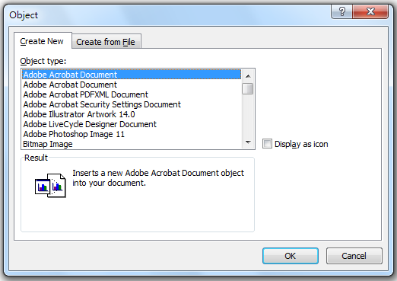
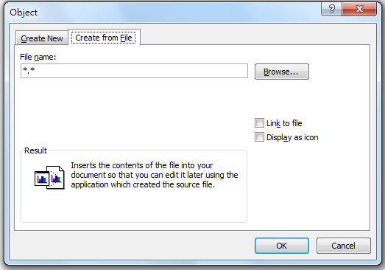
How to use OLE?
3. Create a new file for embedding
or
Choose from the existing files

Slide 6
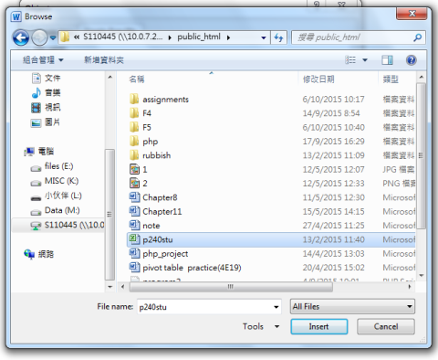
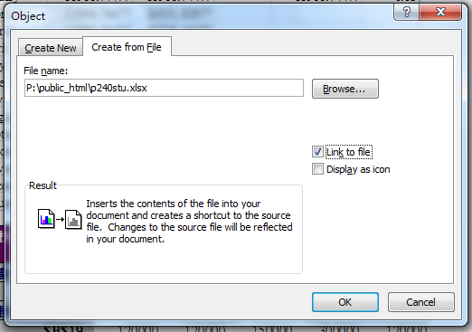
How to use OLE?
5. Choose the file you want
6. Select “link to file” and “Ok”
7.Done!

